Slide 1
Telecom Systems Laboratory TLEN 5460 Routing Protocols
Jose Santos
Interdisciplinary Telecommunications Program

Slide 2
IP Subnetting
Copyright © 2007-19 by Jose Santos

Slide 3
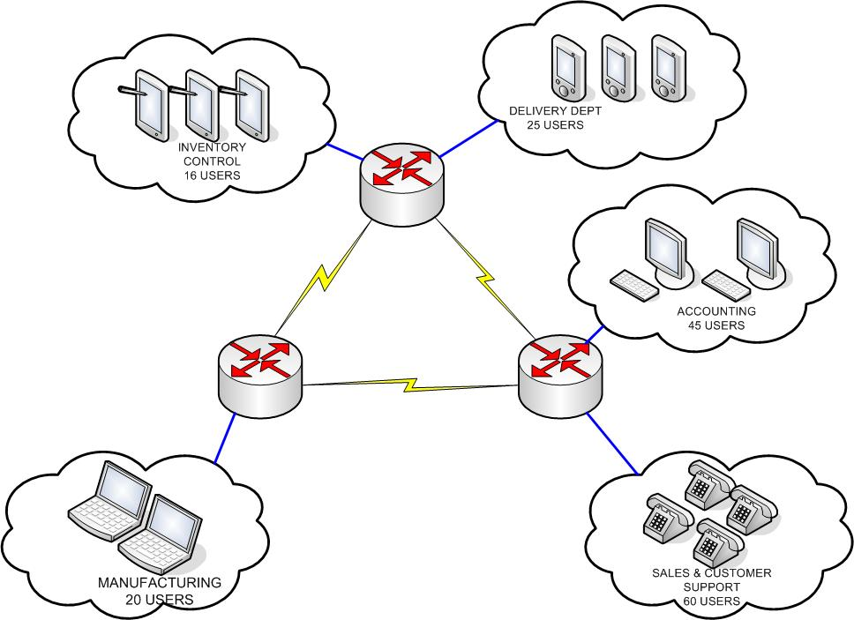
IP Subnetting
Given a Single Class B subnet /24. Support the following network.

Slide 4
IP Subnetting
Don’t forget
Subnet Zero
Broadcast Address
Your Router DG IP address
Your Management IP addresses

Slide 5
IP Subnetting (Homework)
Given a Single Class B subnet /23. Users X 2

Slide 6
IP Subnetting (Homework)
Given a Single Class B subnet /24. Users X 2. Networks X 2

Slide 7
Sample Midterm Q
Design Ip addressing needed for this customer:
4 sites, each with 20 buildings, each with 3 floors, each with 3 different set of users, 109 users of each type per floor. 1 building from each site needs secure network connectivity to other sites, assume you have both public internet access and a private network (assume proper IP addressing: public/private), ensure if one network is down you can still have connectivity between users/sites, ISP is giving you 2 public IP addresses per site.

Slide 8
Routing Protocols

Slide 9
Overview and Terminology
Think beyond directly connected devices
“Network Map” and Routing tables
Static Routes (type the Internet)
Routing protocols: Propagate information about available networks
Routed protocols: L3, protocols that can be routed
Routing type: Link state vs. distance vector
Exterior Routing Protocols: Inter-corporate route distribution
Interior Routing Protocols: Intra-corporate route exchange
Autonomous System: Network under single mgmt/control (ISP)

Slide 10
Routing objectives
Build a routing table (learn & propagate)
Pick best routes (if more than 1 available)
Remove invalid routes
Replace routes if better advertisement received
Restore routes fast (convergence time)
Prevent loops

Slide 11
Exterior Routing Protocols
Border Gateway Protocol (BGP)
Used to exchange route information between AS’s
Cares more about global connectivity rather than specific
Uses TCP
Route exchange is performed with well know neighbors
Every organization has a AS number that uniquely identifies them
Routes are selected on basis of policy / business relationships not on metrics / network parameters
AS prepending prevents loops
Routing tables exceed 1000,000 routes

Slide 12
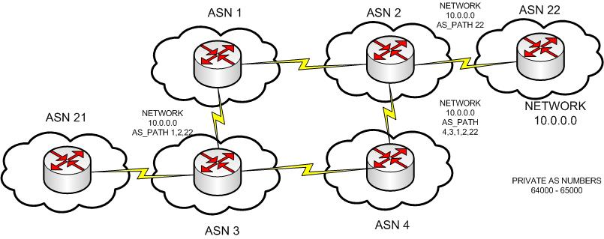
BGP Example

Slide 13
Interior Routing Protocols
Several available in the market. Protocols have evolved over time to respond to changing network conditions
Considerations while choosing a protocol:
Type of routing protocol
Distance vector
Link-state
Hybrid
Update process
Full updates
Partial updates
Convergence time
Metric
Measure of link quality / preference
VLSM support
Subnet size variations
Permit better address allocation
Classless vs. Classful
TX or Not TX mask info
IF TX then VLSM supported

Slide 14
Distance Vector Protocols
DV Logic
Add directly connected
Send updates out include directly connected and learned routes
Listen for routing updates
Routing info: subnet & metric
Use broadcast or multicast for updates
Chose best of multiple routes
Send/expect periodic full updates
If updates no longer received, remove routes learned from such neighbor
Assume that the advertising router is the next hop for a route

Slide 15
Distance Vector Protocols
RIPv1
Metric: hop count (smaller better?). Infinite metric = 16
Full updates every 30s (subnet # & metric)
Convergence 3-5 minutes (depending on size of routing table)
Classful (no VLSM)
Broadcasts updates (255.255.255.255)
RIPv2
Same features as RIPv1
Adds: VLSM support (updates include subnet #, mask & metric)
MD5 and plain text authentication
Includes next hop router IP on updates
Uses external route tags (redistribution)
Multicast routing updates (224.0.0.9)

Slide 16
Distance Vector Protocols
IGRP
Proprietary
Metric: bandwidth + delay (default), reliability, load, MTU
Metric value (1 - 4 billion), smaller better.
Metrics are cumulative: multi-hop path adds links delays
Metrics are configurable
Full updates every 90s
No VLSM supported
Infinite metric = 4,294,967,295 (smaller better)

Slide 17
Link State Protocols
LS logic
Add directly connected
Don’t TX routing info until neighbors are discovered
Routing info: topological information about the network, at the end every router has a complete map of the network.
Use reliable protocol for route updates
Calculate Shortest Path First algorithm (Dijkstra) to determine best routes and next hop (also prevents loops)
Full updates at start and after long periods of time
Partial updates when a link fails
Fast convergence

Slide 18
Link State Protocols
OSPF
Most popular
Discover neighbors, then exchange routes
Reliable Transport Protocol
Run SPF and store best routes
More memory required, more processing
Metric: “cost” based on bandwidth (smaller-better)
Averages 10s convergence time
VLSM supported
Hello messages to confirm neighbor reachability
Full updates every 30 min
Partial updates when link fails

Slide 19
Link State Protocols
Integrated IS-IS
OSI original
Can exchange routing information for multiple L3 protocols
Full flooding every 15 min
Metric: Configurable value, smaller better

Slide 20
Hybrid Protocols
EIGRP
Proprietary
Uses features from both link-state and distance vector protocols (balanced hybrid protocol: topology + routing tables)
Diffused Update Algorithm (DUAL): exchange more info than distance vector but less than link-state
Demands less computation
Calculated best and “feasible successor routes” (alternatives), permits immediate convergence.
Discovers neighbors like OSPF
Metric based on bandwidth and delay (Idem IGRP * 256)
Does not send periodic full updates

Slide 21
Loop prevention in DVP
Problems:
Multiple routes to same network
Miscommunications on a single link
Information loops through alternative paths
Counting to Infinity

Slide 22
Loop Prevention in DVP
Solutions:
Pick up the best
If tie pick the first one or pick both and due load balancing
Split horizon
Don’t TX routes the interface I received it
Route poisoning
When a route fails, advertise it with an infinite metric
Split horizon with poisonous reverse
If a link fails TX routes on all interfaces but with an infinite metric
Hold-down timer
If a route fails don’t accept replacements until some time
RIP (180s), IGRP (280s)
Triggered updates
Send immediate updates after a route fails, don’t wait for update timer

Slide 23
Multiple Equivalent Routes
First learned / Better Metric
Equivalent (routing config mode)
maximum-paths number
defaults to 4, ranges from 1-6
RIP
hop count
balances traffic across the various routes
IGRP
“pretty close metric” concept
variance multiplier
routes in the range of lowest metric * variance are considered equal
traffic-share min
From multiple valid routes on the table take the one with smaller metric (convergence time!)
balances traffic in proportion to metric values

Slide 24
Administrative Distance
Applies to similar routes received from different protocols
Prioritizes different routing protocols (which protocol I believe first?)
Lower the number, the better
Examples:
Directly connected 0
Static Routes 1
EIGRP (internal) 90
IGRP 100
OSPF 110
IS-IS 115
RIP 120
EIGRP (external) 170

Slide 25
“show ip route”
Router1#show ip route
Codes: C - connected, S - static, I - IGRP, R - RIP, M - mobile, B - BGP
D - EIGRP, EX - EIGRP external, O - OSPF, IA - OSPF inter area
N1 - OSPF NSSA external type 1, N2 - OSPF NSSA external type 2
E1 - OSPF external type 1, E2 - OSPF external type 2, E - EGP
i - IS-IS, L1 - IS-IS level-1, L2 - IS-IS level-2, * - candidate default
U - per-user static route, o - ODR
Gateway of last resort is not set
10.0.0.0/8 is variably subnetted, 6 subnets, 3 masks
O 10.0.142.0/30 [110/74] via 10.0.144.2, 00:00:46, Ethernet0
C 10.0.144.0/24 is directly connected, Ethernet0
O 10.0.148.1/32 [110/75] via 10.0.144.2, 00:00:46, Ethernet0
171.68.0.0/26 is subnetted, 1 subnets
C 171.68.178.192 is directly connected, Ethernet0
172.68.0.0/16 is variably subnetted, 2 subnets, 2 masks
I 172.68.0.0/16 [100/8976] via 172.68.1.1, 00:00:02, Serial0
I 172.68.1.0/32 [100/8976] via 172.68.1.1, 00:00:02, Serial0

Slide 26
RIB vs FIB
R 193.108.0.0/17 [117] via 21.2.2.2, 00:16:17, Ethernet0/0
S 193.108.0.0/17 [117] via 24.2.2.2, 00:16:17, Ethernet0/1.3
OIA 193.108.0.0/16 [110/84] via 2.2.2.2, 00:16:17, Ethernet0/0
R 107.12.10.0/24 [110] via 7.7.7.7, 00:12:15, Ethernet0/4
OE1 107.12.10.0/24 [110] via 7.7.7.7, 00:12:15, Ethernet0/4
D 192.16.10.0/24 via 192.17.100.5, 00:00:16, Serial0/0
O 192.16.10.0/24 [AD: ] via 192.19.100.5, 00:00:16, Serial0/0
C 192.20.2.0/24 is directly connected, Ethernet0/0
R 192.20.2.0/24 [AD: ] via 4.3.3.2, 00:11:19
R 192.16.10.0/24 via 192.16.100.5, 00:00:16, Serial0/0

Slide 27
Extended Ping
Ping’s IP source address is by default the one of the exit interface
We are in a router. How can we test if a ping would work from one of the client stations?
Router#ping
Protocol [ip]:
Target IP address: 10.10.10.232
Repeat count [5]:
Datagram size [100]:
Timeout in seconds [2]:
Extended commands [n]: y
Source address or interface: 10.10.20.1
Type of service [0]:
Set DF bit in IP header? [no]:
Validate reply data? [no]:
Data pattern [0xABCD]:
Loose, Strict, Record, Timestamp, Verbose[none]:
Sweep range of sizes [n]:
Type escape sequence to abort.
Sending 5, 100-byte ICMP Echos to 10.10.10.232, timeout is 2 seconds:

Slide 28
VRF
VLAN Concept for layer 3 devices
Separate control plane
-Define VRF
-Port Membership
-Configuration/show commands include vrf name
show ip route vrf vrf-name

